Slide 1
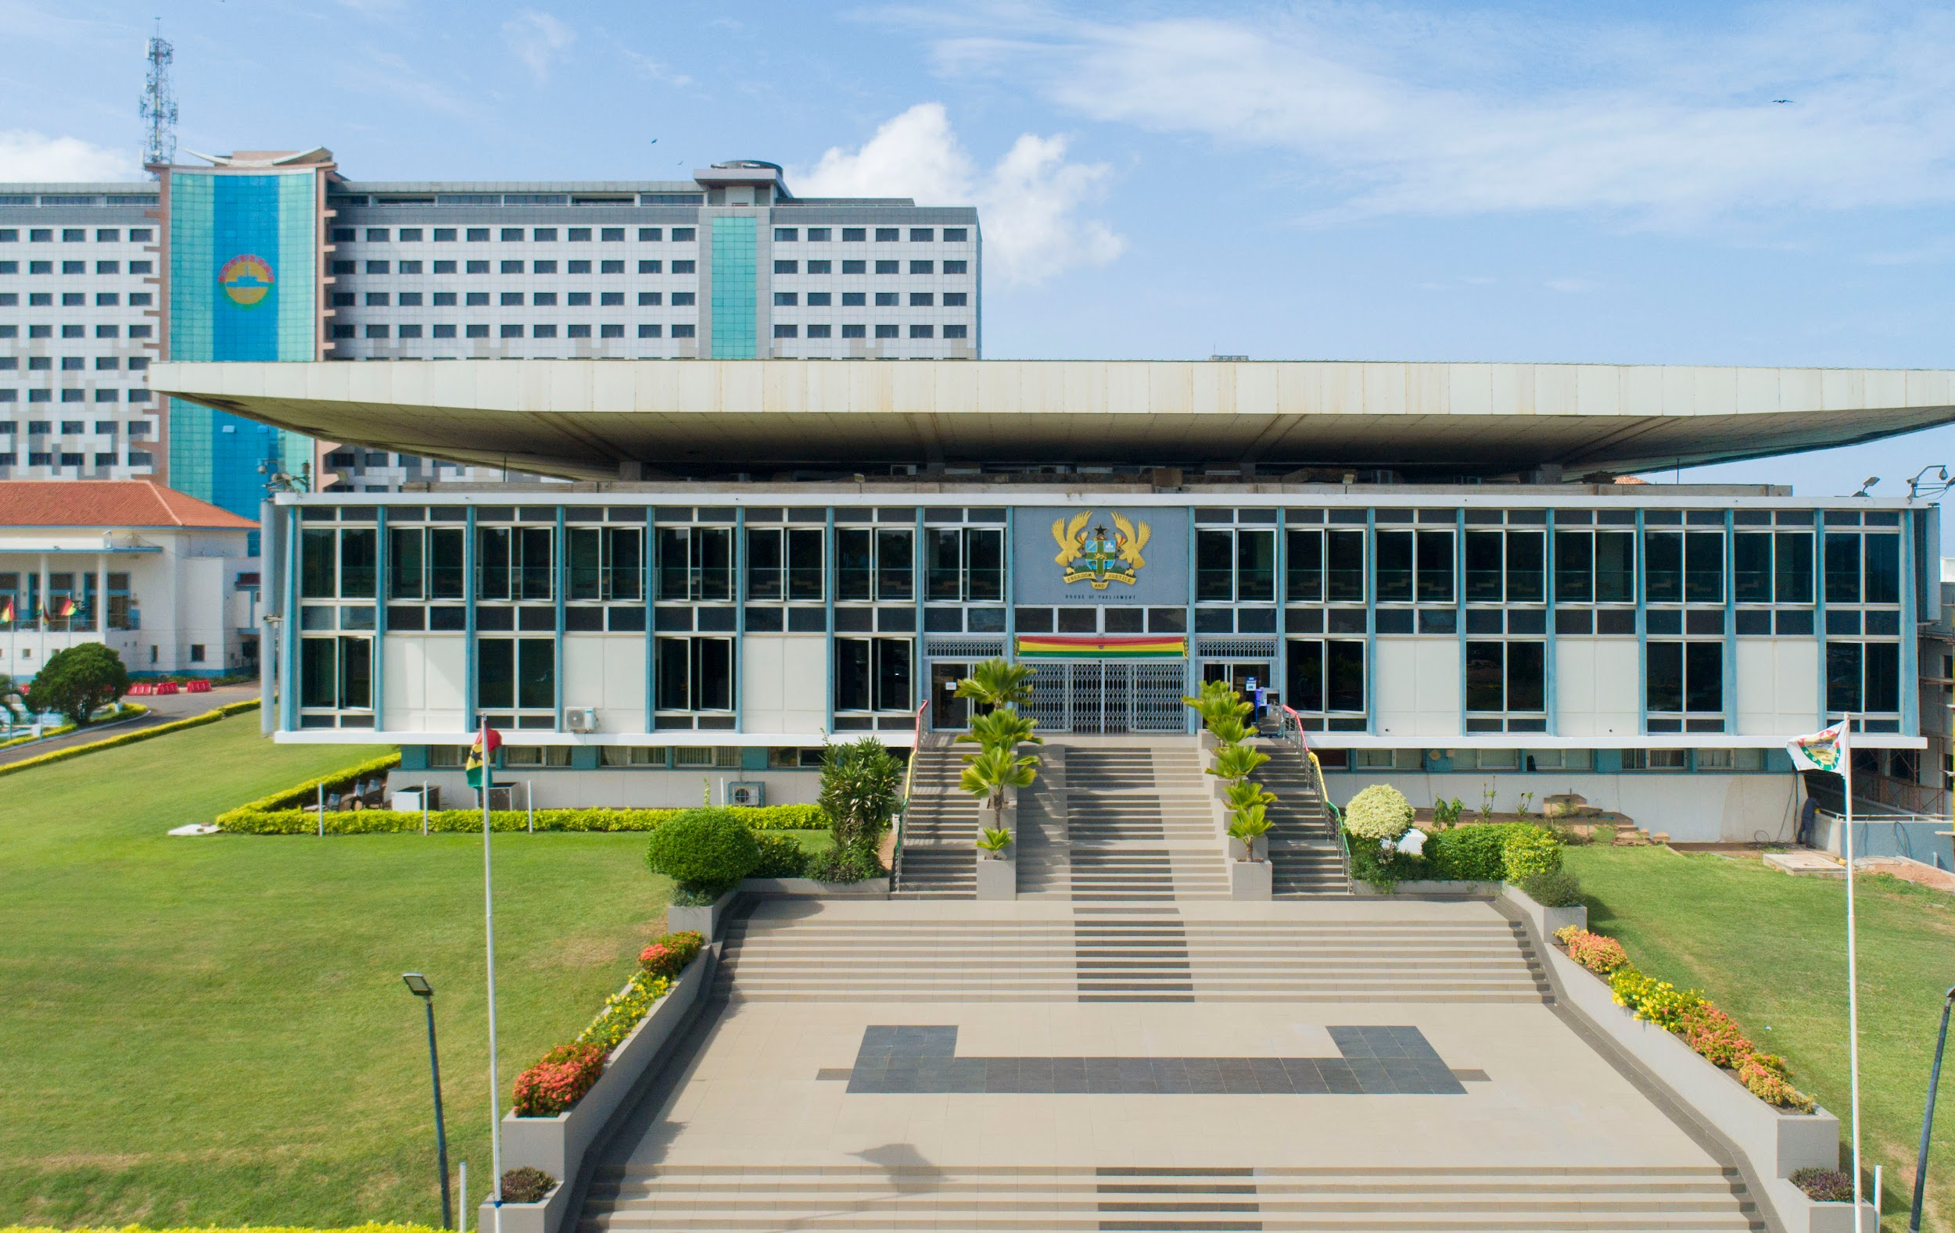
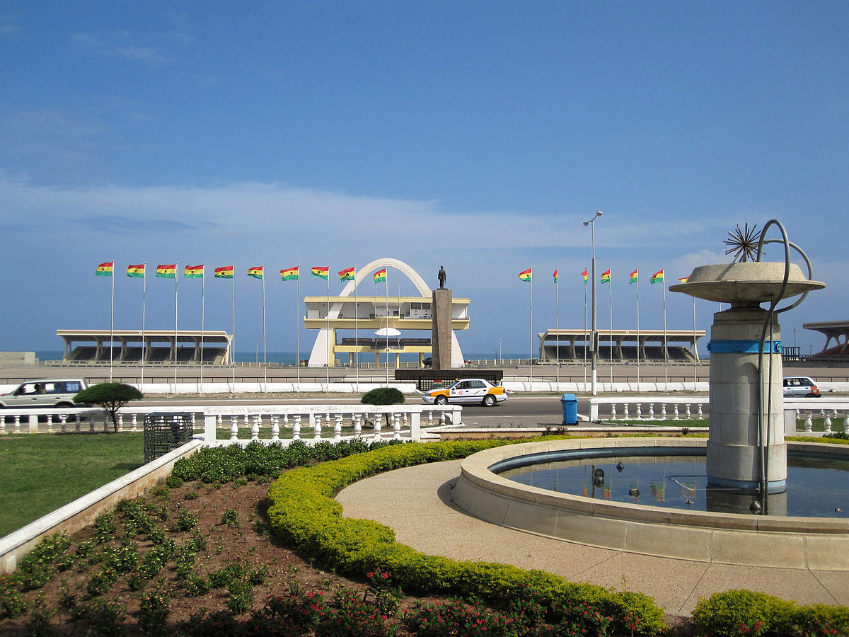








UNDERSTANDING PROJECT SUSTAINABILITY;
An investigation into the Awareness and Certification of Project Management among District Planning Coordinating Units (DPCUs) in Ghana.
EZ BANYE (PMP, PMI-ACP)
July 2024

Slide 2
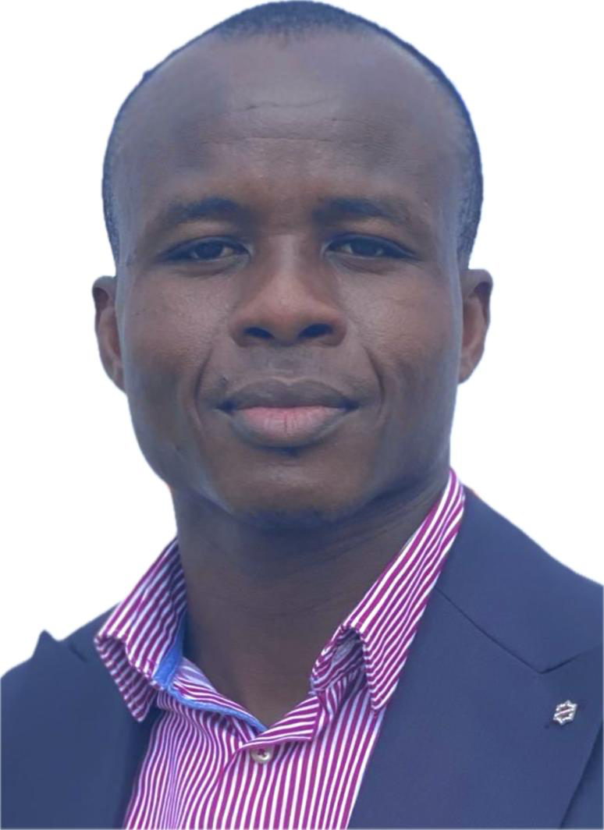
Eric Z. BANYE, (PMP, PMI-ACP)
Project Management Specialist
ezunuo@gmaill.com; 0244881135
Presented at
The NPMC and PMEA 2024
At Rock City.

Slide 3
Abstract.
In the contemporary landscape of project management, the proficiency of Project Managers and the judicious selection of project management methodologies, tools, and techniques are paramount for ensuring project sustainability. As the global economy continues to pivot towards a project-centric paradigm, the practice of project management represents a dynamic fusion of both art and science, necessitating adept navigation of the triple constraints of time, budget, and scope. In Ghana, the District Planning Coordinating Unit (DPCU) assumes a pivotal role in project planning and execution in which the government spends a large chunk of its budget on projects at the decentralized level. However, the pervasive lack of awareness and expertise in project management within this sector has engendered a concerning prevalence of project failures, undermining sustainability objectives.
This study investigates the extent of familiarity with project management certification, methodologies, tools, and techniques among 275 members of 25 randomly selected DPCUs, from the top 50% of the best-performing assemblies in 2022.
Findings indicate a substantial gap in certification, while 82% exhibited awareness of project management certification but are not certified, only 8% were certified, with the remaining 10% of DPCU members are not even aware. Analysis of completed projects underscores significant discrepancies within the triple constraints.
In response to these findings, the study advocates for strategic collaboration between the PMI Ghana Chapter and DPCUs to bolster capacity-building initiatives aimed at certification and practical application of project management principles.
Disclaimer
The views and opinions expressed in the following PowerPoint slides are those of the individual presenter.
………………….
All references acknowledged in the paper write up.

Slide 4
Presentation Structure
Background
Objectives
Project Sustainability
Methods, tools and techniques
The DPCUs in Ghana
PM methodology
Findings
Lessons Learnt
Recommendations
Conclusions

Slide 5
GROWING DEMAND.
80% of government projects are carried out at the decentralised level
PROJECT MANAGERS.
There is a statutory body/UNIT responsible for Project PIM&E
BACKGROUND
PROJECTS FAILURES.
Govt projects are beret with project failures and most often with no SUSTAINABILITY in mind.
PMI Ghana Chapter has been embacking on a massive drive for members and certification
Notes:
LAST year, presented on project failure ref Agenda 11
Was informed that capacity is a key problem
So in 2024, while supporting assemblies to design some projects
I observe most of them had no clue in PM
Again PMI is running around encouraging certification

Slide 6

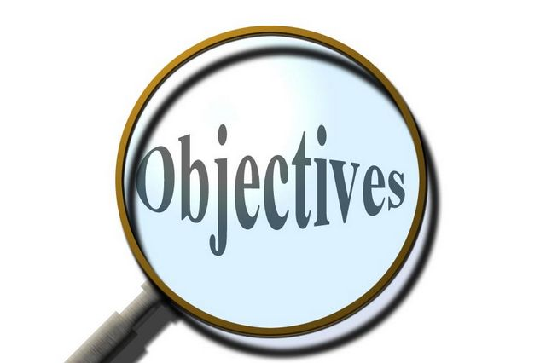
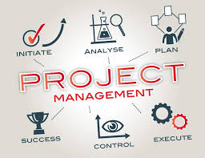
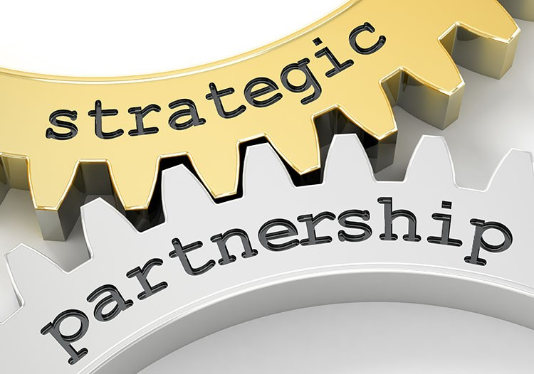

To deepen understanding of project sustainability at the decentralised level.
A better understanding of project management at the decentralized level.
To advocate for strategic collaboration.
To spark a dialogue of how to effectively use our taxes on projects.

Slide 7
THE PROJECT

Slide 8
Projects should be considered successful and relevant if they deliver value to the present and future generations.

Slide 9
A temporary endeavor undertaken to create a unique product, service, or result. The temporary nature of projects indicates a beginning and an end to the project work or a phase of the project work.
The Project
Notes:
Daily involvement in PM consciously or unconsciously
Eg waking up to plan day, bathing, cooking to eating
Even coming for this event.

Slide 10
has a unique purpose
is temporary.
drives change and enables value creation.
requires resources, often from various areas.
have a primary customer or sponsor.
involves uncertainty.
Project
Attributes
Notes:
Daily involvement in PM consciously or unconsciously
Eg waking up to plan day, bathing, cooking to eating
Even coming for this event.

Slide 11
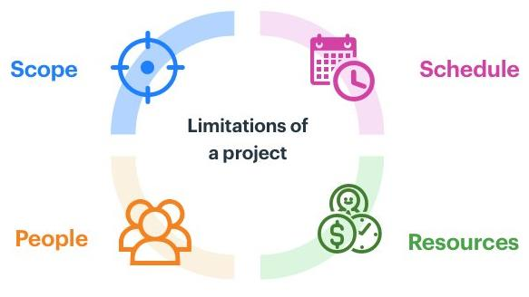
The project constraints
At Assemblies;…...
Quality
Political Demands from the People
Strategic Deception
SUSTAINABILITY

Slide 12
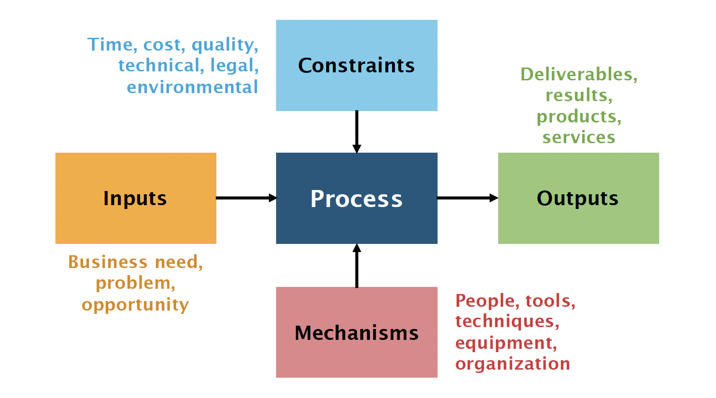
Project management refers to the application of knowledge, skills, tools and techniques to project activities to meet project requirements and objectives
Application of mechanisms to inputs to generate outputs while subject to constraints

Slide 13
Implementation
Value for money
Interference
SUSTAINABILITY
Decentralized projects x’tics by…..
  implementation inefficiencies (internal)
  Limited value of the project (internal)
  Political interference (external)
  SUSTAINABILITY (combination)

Slide 14
What’s the
concern?
Globally, projects have become conduit for delivering value to society.
But the SUSTIANABILITY of these projects is becoming concern.
The media inundated with project time and cost overruns, as well as their outright abandonment, no value for money.
At the decentralised level, public infrastructural projects are becoming the most “notorious” culprits

Slide 15
What’s the concern?
  Increasing share of our gross domestic product (GDP) is spent financing projects.
  Citizens taxes and “unscrupulous loans” are used to embark of these unsustainable projects.
  Over 80% of projects at the decentralised level.

Slide 16
Access to data……Problematic
SCOPE
TIME
PROJECTS
SUSTAINABILITY
BUDGETS
No Clarity on DoD

Slide 17
Budget expenditure and sustainability (Mid year budget)
GH¢5.4 billion spent to support LEAP, School Feeding programme, Capitation Grant and NHIS since January, 2024
GH¢1.5 billion on Free SHS programme between January and June this year. (over GH¢ 9.9 billion to date)
over GH¢662 million was paid to caterers as at June 2024
GH¢38 million as Capitation Grant for the first half of 2024
Spent GH¢12 billion on Domestic Debt Exchange programme, since February
Invested GH¢10 billion in the Road Sector since January, 2024
Invested about GH¢135 million in the National Identification Programme
the disburse GH¢1.5 billion to provide relief and bailout for locked up capital
US$6.1 million on youths in agriculture entrepreneurship
GH¢750 million CAP-BuSS Programme to directly Support Micro, Small and Medium-Sized Enterprises

Slide 18
Projects
Irregularities
Sustainability
Between 2022 and 2023, savings from irregularities about
GH¢ 5.2 billion
  A reduction by 32%.

Slide 19
Even worse ……in Ghana
  There is disconnection between the National plans developed by NDPC and the political manifestos of governing parties.
  Therefore projects planned at decentralised levels lack the needed resources and commitment to be executed fully.
  This is further worsened by the AWARENESS and CERTIFICATION of the implementers of Project Management Methodologies, tools and Techniques (MTTs)

Slide 20
UNDERSTANDING PROJECT
SUSTAINABILITY

Slide 21
What is Sustainability?
Sustainability is a term used very widely today, but what does it actually mean?
Sustainability “has become one of the most over used and abused words in the devt/govt vocabulary”
Eg;…………………………………………………………………..

Slide 22
What is Sustainability?
‘The term sustainability takes into consideration future developments and changes that do not damage the environment, create economic growth and benefit the lives of people (social) simultaneously for the present and future generations.’

Slide 23
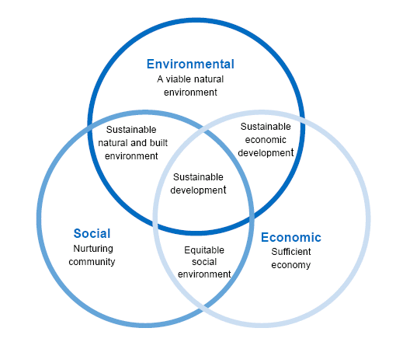
More inclusive definition from the Brunt land Commission as "meeting the needs of the present without compromising the ability of future generations to meet their own needs"
(Brundtland, 1987).
SUSTAINABILITY

Slide 24
PROJECT SUSTAINABILITY
The capacity to continue to deliver its intended benefits over a long period of time.
Donors and governments
  + + + project implementation and
  - - - on issues of operation, maintenance, and sustainability.
Most focus is on projects' economic viability with little attention to the impact of projects on environment or the conditions of the poorest sectors of society

Slide 25
PROJECT SUSTAINABILITY
In Ghana, Project Sustainability is a major challenge
  political env’t (will, changes, corruption, nepotism),
  other social, cultural, environmental
  Implementers capacities in PM
  technological transformation,

Slide 26
PROJECT SUSTAINABILITY
Project Sustainability……. will require
Re-engineering of the planning sustem and structure
Improving human capacity project management professionals in applying the Project Management MTTs
DPCUs members

Slide 27
Project Management Methods, Tools and Techniques
According to a Chinese proverb, “to do good work, one must first have good tools.”

Slide 28
Project Management Methods, Tools and Techniques
Project management knowledge areas describe the key competencies that project managers must have.
Project management tools and techniques assist project managers and their teams in carrying out work in all knowledge areas.
PMTTs mean systematic procedures or practices that are used for producing specific project management deliverables.

Slide 29
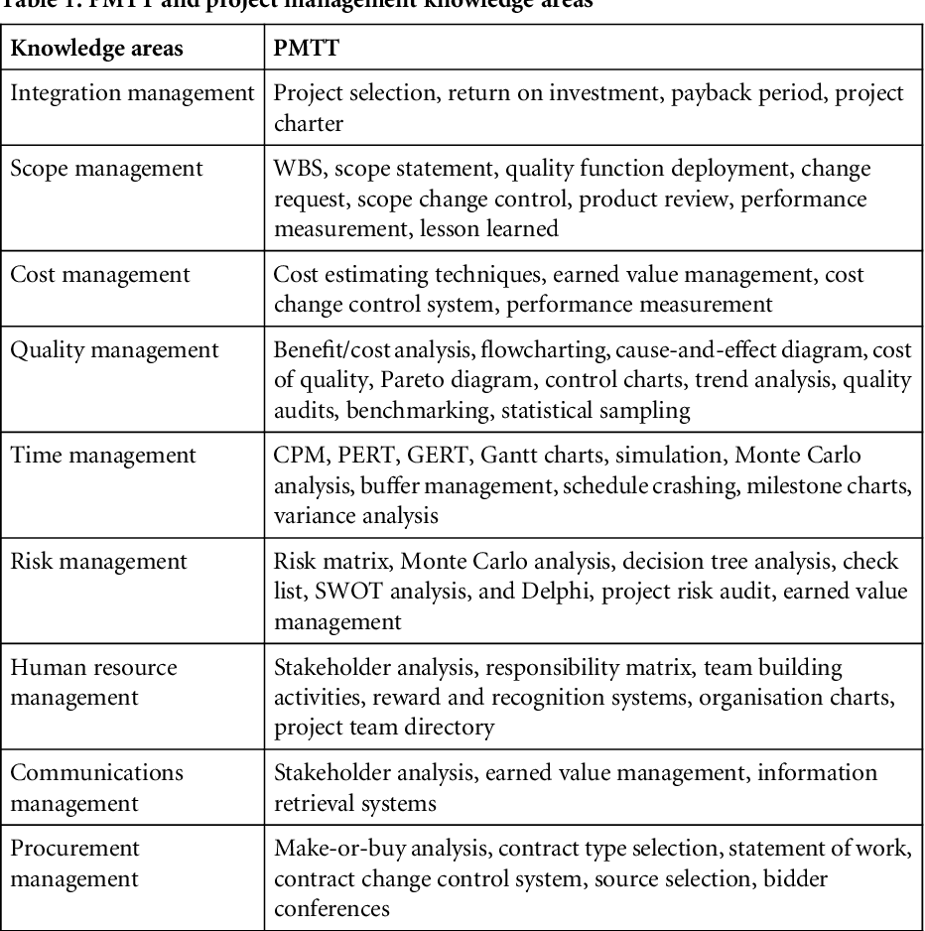

Slide 30
PM MTTs Relevance
Good application of knowledge, skills, tools, and techniques can raise the probability of success and sustainability.
Studies highlight that one reason for project failure is an inappropriate use or misuse of PMTT
Appropriate use of PMTT leads increase efficiency, improve project predictability, increase stakeholder confidence, project success, and improve communication.
Knowledge developed;
The Project Management Institute (PMI),
Project Management for Development (PM4DEV)
The IPMA Competence Baseline (ICB),
International Standardization Organization (ISO) 9000,
Project IN a Controlled Environment (PRINCE2),
Project and Program Management (P2M),
C-PMBOK, and others are some other accredited standard-setting bodies
Green Project Management
Institute of Project Management Professionals-IPMP

Slide 31
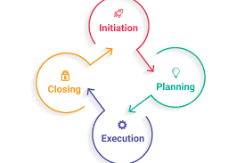
The case of the
District Planning and Coordinating Units (DPCUs) In Ghana.

Slide 32
The DPCUs are responsible
Facilitate and coordinate the preparation development plans of the District
Lead monitoring and evaluation activities of the District
Coordinate implementation of development programmes, projects and activities in the District
Coordinate and harmonize operations of Departments of the Assembly and other development partners
Provide strategic advise to the District Assembly on matters relating development of the Assembly
To provide operational support in the implementation of development policies and programmes.
Lead in strategic planning, efficient integration and implementation of the public policies and programmes to achieving sustainable economic growth and development.

Slide 33
COMPOSITION
Municipal
Municipal co-ordinating director
Municipal planning officer
Municipal budget officer
Municipal director. Finance Department
Municipal director. Health Department
Municipal director, Department of Education, Youth and Sports
Municipal director, Directorate of Agriculture
Municipal director, Department of Social Welfare and Community Development
Municipal director, Department of Trade and Industry
Municipal director, Physical Planning Department
Municipal director, works ordistrict engineer
Municipal director, Disaster Prevention and Management Department
Municipal director, Natural Resources Conservation, Department of Forestry, Game and Wildlife Division
Municipal director, Transport Department
Municipal director. Urban Roads Department
Convener of the development planning subcommittee of the executive committee
A representative each of civil society, traditional authority, identified and selected by the district planning authority with the right to vote
Amaximum of five representatives of relevant non-decentralised agencies and organisations co-opted by the district planning unit with the right to vote
Metropolitan
Metropolitan coordinating director
Metropolitan director. Works Department
Metropolitan director, Physical Planning Department
Metropolitan director, Department of Trade and Industry
Metropolitan director, Directorate of Agriculture
Metropolitan director, Department of Social Welfare and Community Development
Metropolitan director. Legal Department
Metropolitan director. Waste Management Department
Metropolitan director, Urban Roads Department
Metropolitan director. Budgeting and Rating Department
Metropolitan director, Transport Department
Metropolitan director, Finance Department
Metropolitan director. Education, Youth and Sports Department
Metropolitan director, Health Department
Metropolitan director, Natural Resources Conservation Department of Forestry, Game and Wildlife Division
Metropolitan director. Disaster Prevention Department
Convener of the development planning subcommittee of the executive committee
A representative each of civil society and ttie traditional authority identified and selected by the metropolitan planning authority with the right to vote
A maximum of five representatives of relevant non-decentralised agencies and- organisations co-opted by the metropolitan planning unit with the right to vote.
District
District co-ordinating director
District planning officer
District budget officer
District director. Finance Department
District director. Health Department
District director. Department of Education, Youth and Sports
District director, Directorate ofAgriculture
District director, Social Welfare and Community Development
District director,
Department of Trade and Industry
District director, Physical Planning Department
District director, works or district engineer
District director. Disaster Prevertion and Management Department
District director. Natural Resources Conservation, Department of Forestry, Game and Wildlife Division
Convener of the development planning subcommittee of the executive committee
A representative each of civil society, traditional authority, identified and selected by the district planning authority with the right to vote
Amaximum of five representatives of relevant non-decentralised agencies and organisations co-opted by the district planning unit with the right to vote

Slide 34
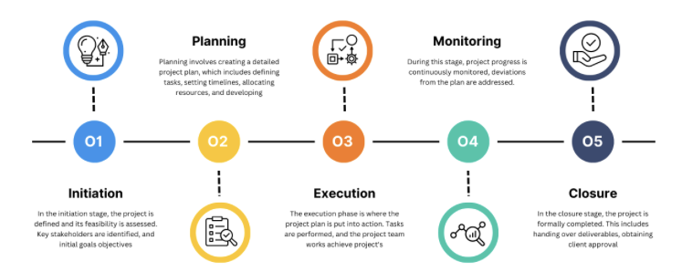
The DPCUs……..

Slide 35

LEGAL AND INSTITUTIONAL FRAMEWORK
National Development Planning (Systems), Act 1994, Act 480
  Describes the system as decentralized: national, regional and district level
  Defines the functions of Planning authorities at all decentralized levels
National Development Planning (Systems), Regulation 2016, L.I 2232
  Format for development plans
  Specifies the date to submit key documents
Local Government Act, 2016, Act 936
Local Government Service Act, 2003, Act 656.
Institute of Local Government Studies Act, 2003, Act 647
Public Financial Management Act, 2016, Act 921
Public Financial Management Regulation, 2019, L.I 2378
Land use and Spatial Planning Act, 2016 (Act 925)
Civil Service Act, 1993 (PNDC Law 327)
Statistical Service Act, 2019 (Act 1003)
Main Legislation

Slide 36
The DPCU produces a MTDP in the form of…
Executive summary
Chapter 1: Performance review/profile/current situation/baseline
Chapter 2; Key development issues and priorities
Chapter 3: Development goal, objectives and strategies
Chapter 4: Composite development programmes
Chapter 5: District composite annual action plan
Chapter 6: Monitoring and evaluation arrangements
Chapter 7: Communication Strategy
Waterfall approach
PMTTs are crucial for sustainability
Are the DPCU aware and certified?

Slide 37
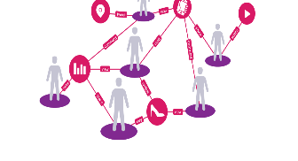


Methodology
Mixed
Methods
25 randomly selected DPCUs, from the top 50% of the best-performing assemblies in 2022
275 individuals purposefully selected

Slide 38
Findings
Background in PM.
Mostly social sciences
Old officers had planning banckground
Newer ones are learning on the job
PM is not a main criteria for their engagement
Some participated in in-service training offered by NDPC and other NGOs eh EU, GIZ etc
Strong desire for PM among members

Slide 39
Findings on Project constriants
BUDGETS;
4 budgets (Planned, approved, disbursed and spent)
Planned budget
60-80% approved
Less than 60% disbursed
Expenses vary
TIME;
Less than 20% on schedule
70% never gets to be completed
Some are abandoned/stalled/delayed
Time depended on budget
SCOPE;
Less than 30% within scope
Most are rescoped for several reasons
Scope will almost always change
Change is drastic when projects transitioned into next govt
Scope developed without budgets
Documentation for changing mostly not done
QUALITY;
Compromise by non-use of PM MTTs due to political interference

Slide 40
Varied opinions
“Eeeh, in this our system, your knowledge doesn’t matter oo. The politicians decide how things are done. Also if govt doesn’t release funding, what can you do?”
“Even if you are certified and you find yourself in this system, you can’t work. The system is so structured and rigid”
“Funding is our main problem, not the skills. I think we can implement projects if given the resources and allowed to implement’
“I did project management in KNUST, but I now want to certified. I think the certification and membership will be useful for me to move up the ladder in the public service”
“We have projects in the MTDPs which we are uncertain of the funding availability and we also have ongoing projects initiated from Accra (Politicians) which we don’t have control but are required to monitor. What do you monitor when you don’t have details of the project?”

Slide 41
Going forward….
Strategic collaboration between the PMI Ghana Chapter and DPCUs to bolster capacity-building initiatives aimed at certification and practical application of project management
Despite limitations, it contributes valuable insights into the root causes of project failures at the district level, underscoring the need for enhancing project management competencies to foster sustainable development outcomes at the decentralized level.
Develop collaboration with the mandatory bodies like OHLG, ILGS, NDPC, MLGRD and RCCs to introduce PM MTTs.
Ghana needs a national development framework that’s spells out large scale capital-intensive projects where political manifestoes will only present the HOW and WHEN and not the WHAT.
Govt needs to engage professional management bodies like PMI to provide professional PM training and certification, advice before, during, and after the taxed-payers project.

Slide 42
Conclusions
Irrespective of the level of awareness, knowledge and certification, the continuous disjoint uncoordinated planning, and manifesto-based implementation system in Ghana, will continue to constitute the basis of several unsustainable projects at the decentralized level.

Slide 43


